Slide 1

Computer Architecture
Keivan Navi
Cal Poly Pomona University
knavi@cpp.edu
Office hours: Tu/Th 5:25 Pm to 6:55 Pm
Office: 8-49

Slide 2
Computer Architecture
Some Sample CPU Architectures

Slide 3
Different Instruction Format will result in different CPU Architecture and Vice Versa
Operation Operand Format: As an example:
Add 100 -> AC<= AC +(100)
It seems we can add the accumulator with any memory cell in the main memory.
But in reality the realization of this, may result in a huge delay in some cases, even if it is doable.
Imagine that we need the same memory cell for the next instruction. Then we are obligated to spend extra time to access the main memory for the same information.
It is better to use an intermediate register to save the possible required data.

Slide 4
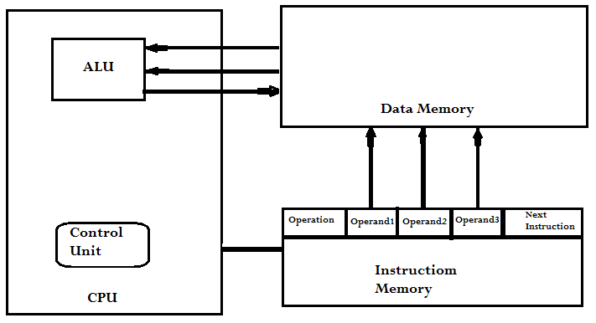
Memory-Memory Architecture (Separate Memory/ Harvard Architecture) Operation Operand1, Operand2, Operand3, Next Instruction Add 100,101,104 100 <= (101) + (104)
The programmer must take care of the next address. There is no program counter.

Slide 5
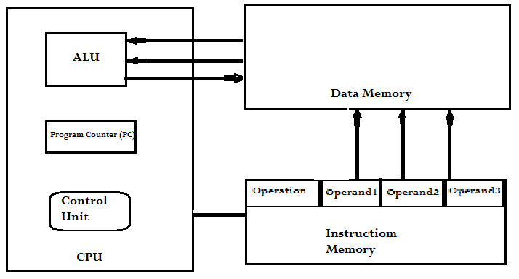
Memory-Memory Architecture (Separate Memory/ Harvard Architecture) Operation Operand1, Operand2, Operand3 Sub 100, 105,102 100 <= (105) – (102)
The Program Counter (PC) is the responsible of defining the next instruction, in other words the programmer won’t take care of it:

Slide 6
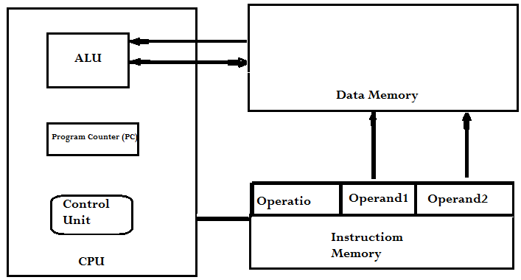
Memory-Memory Architecture (Separate Memory/ Harvard Architecture) Operation Operand1, Operand2 And 100, 105 100 <= (100) . (105)
Operand1 can act as “Source” as well as “Destination”.

Slide 7
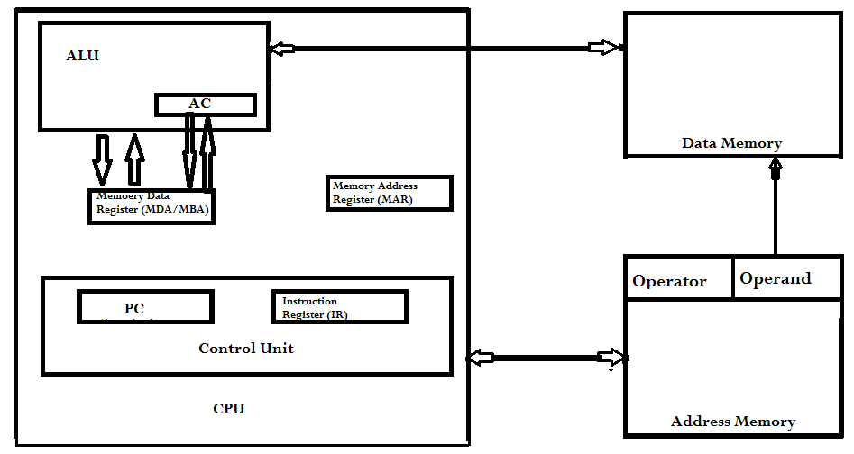
Register-Memory Architecture (Separate Memory/ Harvard Architecture) Operation Operand Add 70 ac <= (ac) + (70)
Accumulator is “Source” and “Destination” and one operand reside in the memory.

Slide 8
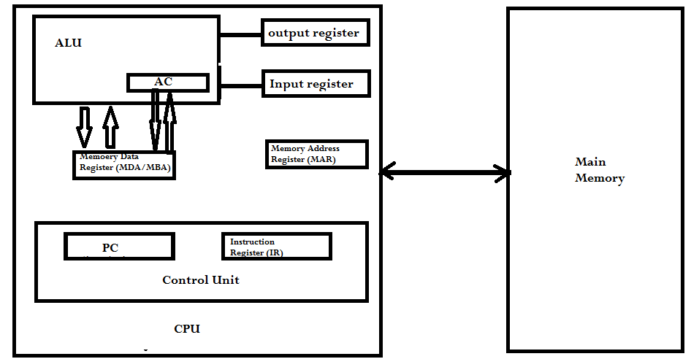
Register-Memory Architecture (Unified Memory / Von Neumann Architecture) Operation Operand: Add Mem1 (Add 100) AC<= AC +(100)
The next page flowchart explains the behavior of this CPU

Slide 9
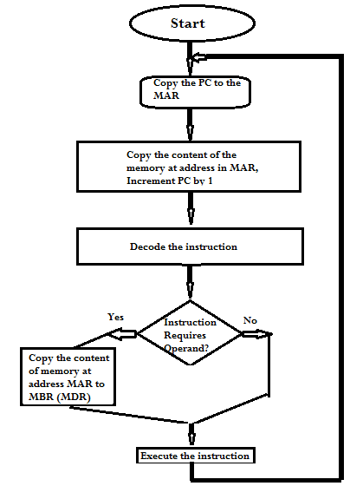
Register-Memory Architecture (Unified Memory / Von Neumann Architecture) continued

Slide 10
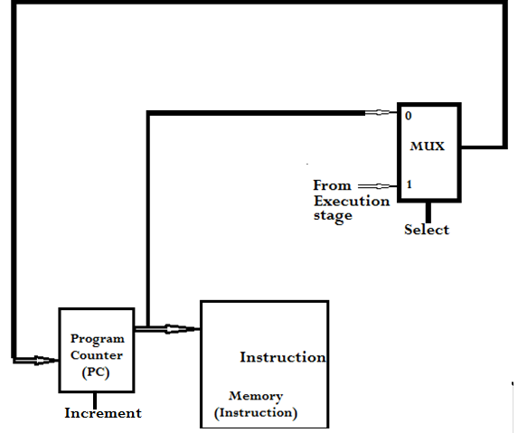
Simple Fetch Architecture example
Fetch: In the fetch cycle, the CPU retrieves the instruction from memory. The instruction is typically stored at the address specified by the program counter (PC). The PC is then incremented to point to the next instruction in memory.

Slide 11
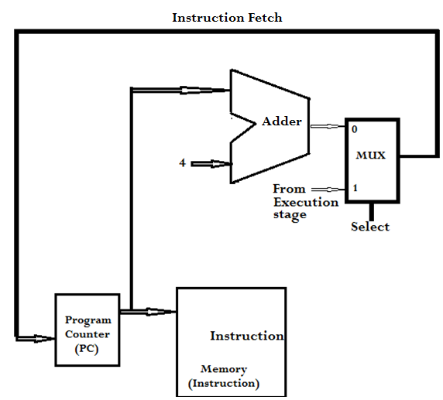
Instruction Fetch ( each word is 4 bytes)
Instruction Fetch:
An Instruction pointed by Program Counter is loaded from the main memory into the CPU. The PC is incremented 4 times, because the word size is 4 bytes.

Slide 12
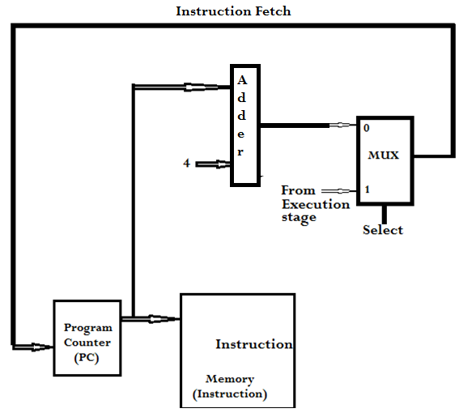
Using “Adder” instead of ALU to add 4 to the content of the program counter

Slide 13
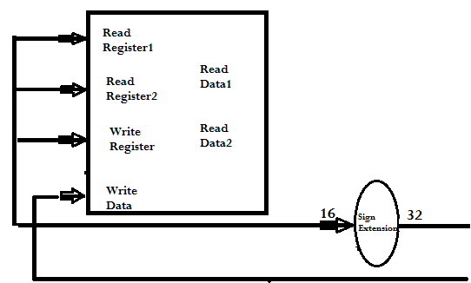
Instruction Decode/ Register File Read
When decoding the instruction, first we must find out what is the instruction, then we must access the register file to read the required registers. A more profound explanation of all the stages and overall function of a CPU will be discussed later.

